Slide 1

Capstone project - phase 2
De novo study of planet movement based on sky images and Newton’s model
By: Ibraheem Sabaane
Mario Rohana
Supervisor: Dr. Zeev Frankel
1

Slide 2
Goals
Evaluating whether kinematics and Newton's laws alone are sufficient for observing and understanding the movements of stars and celestial objects.
Object detection in sky images.
Investigating the accuracy and validity of theories learned in school regarding celestial motions.
2
Notes:
ibraheem:
Our objective is to check if it's possible and accurate to study the movements of celestial bodies using only kinematics and Newton's laws. We want to put these fundamental theories to the test in the realm of astronomy.
By conducting meticulous observations and analysis, we seek to verify the reliability and applicability of the theories we've learned. Our goal is to contribute to the field of astronomy and expand our understanding of the universe.
Through this project, we embark on a scientific journey to explore the accuracy of our school-taught theories in explaining the dynamic nature of celestial motions.
In addition to our main goal, our project encompasses two distinct approaches. The first approach involves constructing a mathematical model for the solar system using the principles of kinematics and Newton's model. In this approach, we input parameters related to the objects in the solar system into our program. Using Newton's model, the program then simulates the expected motions of the planets based on these parameters.
The second approach is based on image analysis. We provide the program with images of the sky, and through advanced image processing techniques, the program is able to detect and identify different celestial objects. It then uses these images to reverse engineer the motions of the objects, extracting valuable parameters such as speed, acceleration, and more. This approach allows us to derive the mathematical model of the objects without having prior knowledge of their initial parameters.

Slide 3
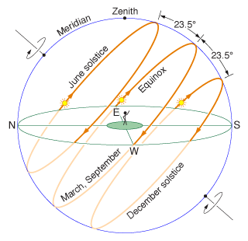
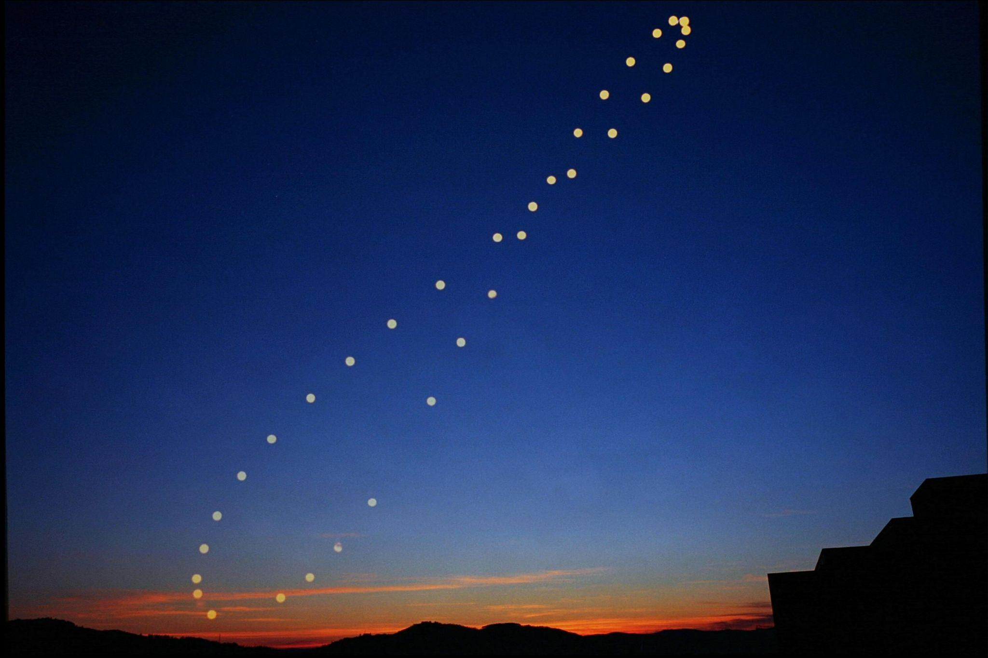
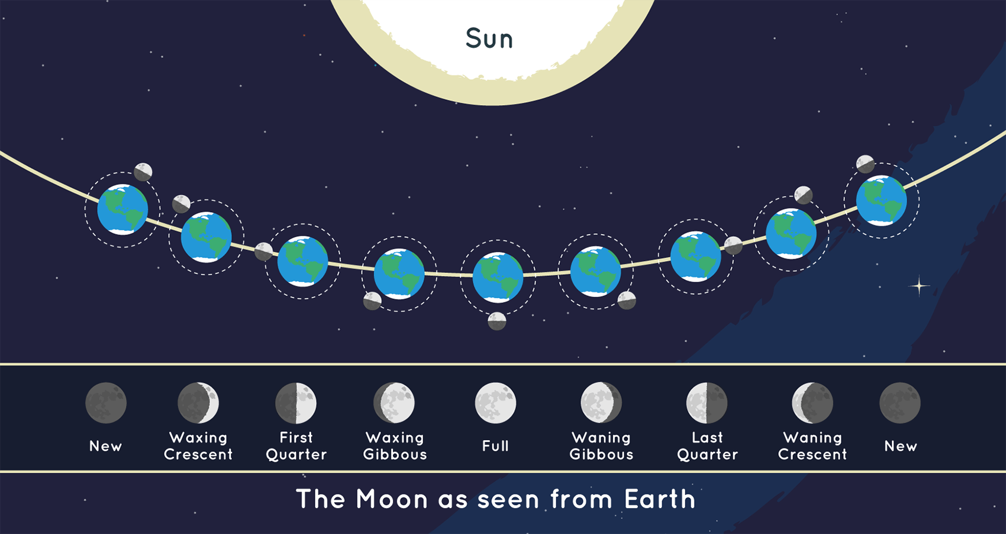
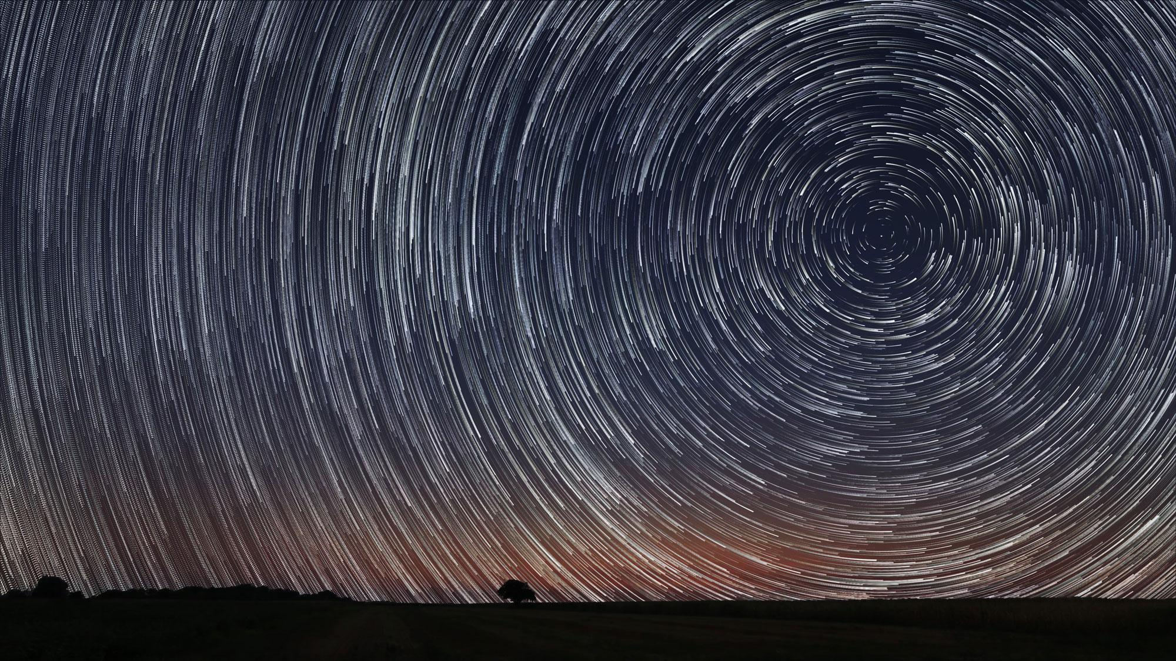
Background
3
Notes:
mario
The most important element of our project is the movement of the celestial objects, such as the sun, planets, moon, stars. If you observe the sky from the earth you will notice distinct patterns in the movement
The first image here shows the Sun's path across the sky, which appears to move in an arc due to the rotation of the Earth.
That is why we see star trails forming circles in the night sky. This is a result of the Earth's rotation and the immense distance of the stars from us.

Slide 4
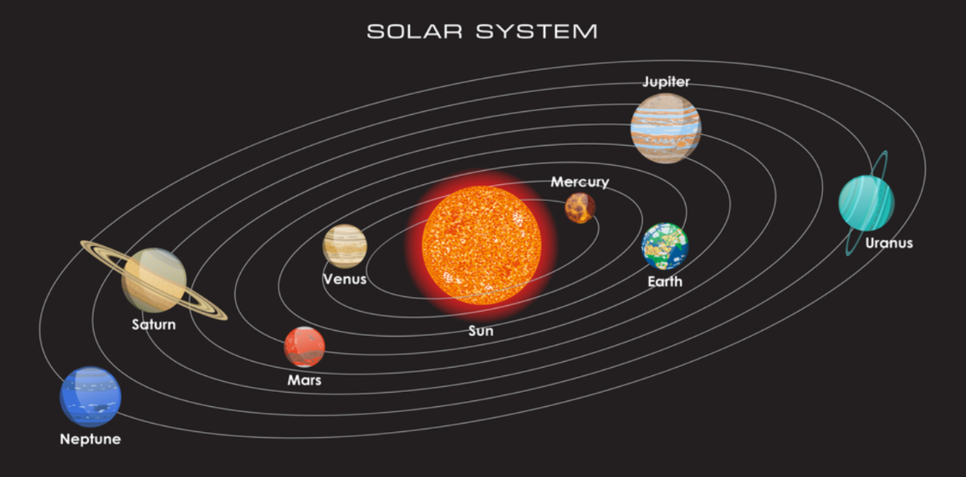
Background
4
Notes:
ibraheem
In this slide, we will explore our solar system and the fascinating movements of the planets around the Sun.
Understanding the structure and the dynamics of our solar system is crucial for our project objectives.
As you can see the solar system consists of the sun at the center serving as the gravitational anchor for all the celestial bodies within it.
We can see the eight planets of the solar system where each planet has its size,composition, distance from the sun hence each planet has its own gravitational force and movement speed.

Slide 5
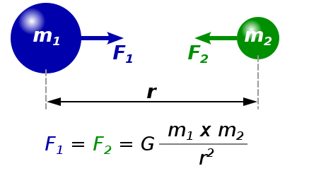
Newton’s Model of Planetary Motion
Newton’s first law: In the inertial coordinate system with no forces v=const
Newton’s second law: ∑F = ma
Newton’s third law: F₂₁=-F₁₂
The law of universal gravitation: F = G*(m₁*m₂)/r²
5
Notes:
ibraheem:
Newton's first law: An object at rest will remain at rest, and an object in motion will continue in a straight line at a constant speed unless acted upon by an external force.
Newton's second law: F = ma, where F is the net force acting on an object, m is its mass, and a is its acceleration.
Newton's third law: For every action, there is an equal and opposite reaction.
The law of universal gravitation: F = G * (m1 * m2) / r^2, where F is the gravitational force, G is the gravitational constant, m1 and m2 are the masses of two objects, and r is the distance between them.
Newton's model provides a comprehensive framework for understanding the dynamics of planetary motion.
It allows us to calculate the positions, velocities, and accelerations of planets at any given time.
By studying the forces and interactions between celestial bodies, we can make accurate predictions of their future positions and motions.

Slide 6
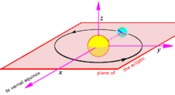
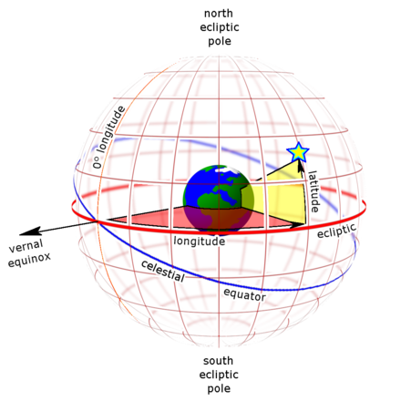
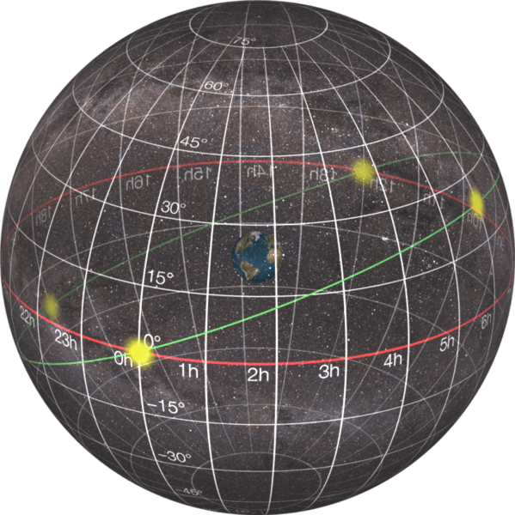
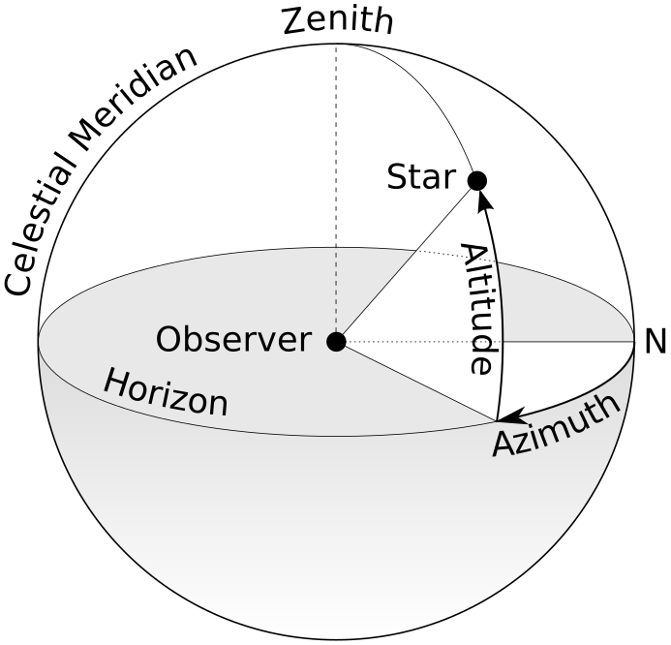
Celestial coordinate systems
Heliocentric coordinates
Ecliptic coordinate system
Equatorial coordinate system
Horizontal coordinate system
6
Notes:
it's important to know how to precisely locate celestial bodies. By understanding the celestial coordinate systems, we can effectively navigate the vastness of the cosmos and pinpoint the positions of planets, stars, and other celestial objects. here, I will introduce you to four key coordinate systems that enable us to do just that: Heliocentric Coordinate System, equatorial coordinate system, the ecliptic coordinate system, and the horizontal coordinate system.
Heliocentric Coordinate System:The first image showcases the heliocentric coordinate system, which centers on the Sun. This system is particularly useful for studying the overall structure and dynamics of the solar system. It enables us to accurately track the positions and orbits of planets, asteroids, and other solar system objects relative to the Sun.
Ecliptic Coordinate System:The second image represents the ecliptic coordinate system, which is based on the plane of Earth's orbit around the Sun, known as the ecliptic. This system is particularly relevant for studying objects within the solar system, such as planets and comets. Ecliptic longitude and ecliptic latitude are used to pinpoint the positions of these objects relative to the ecliptic plane.
It represents the apparent path that the Sun follows throughout the year as observed from Earth. The ecliptic serves as a reference plane for studying the motion and positions of celestial objects within the solar system.
Equatorial Coordinate System:The third image illustrates the equatorial coordinate system, a widely used system for locating celestial objects based on their positions relative to the celestial sphere. This system centers on the Earth and is aligned with Earth's equator and celestial poles. It employs coordinates such as right ascension (analogous to longitude) and declination (similar to latitude) to precisely specify the locations of objects in the sky.
Horizontal Coordinate System:The fourth image showcases the horizontal coordinate system, which provides a view of the sky from a specific observer's location on Earth. This system is based on the observer's horizon, with coordinates such as azimuth (measured along the horizon) and altitude (measured vertically). It allows us to easily identify and track objects as they rise, set, and move across the sky.

Slide 7
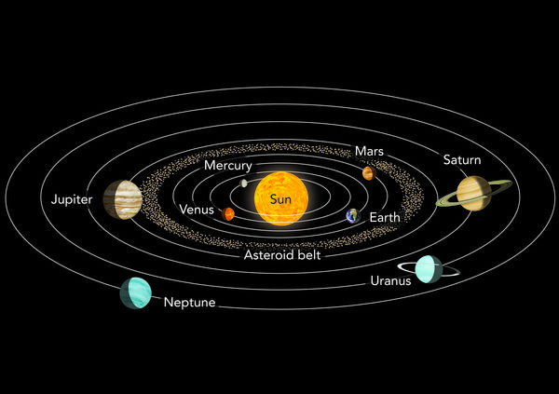
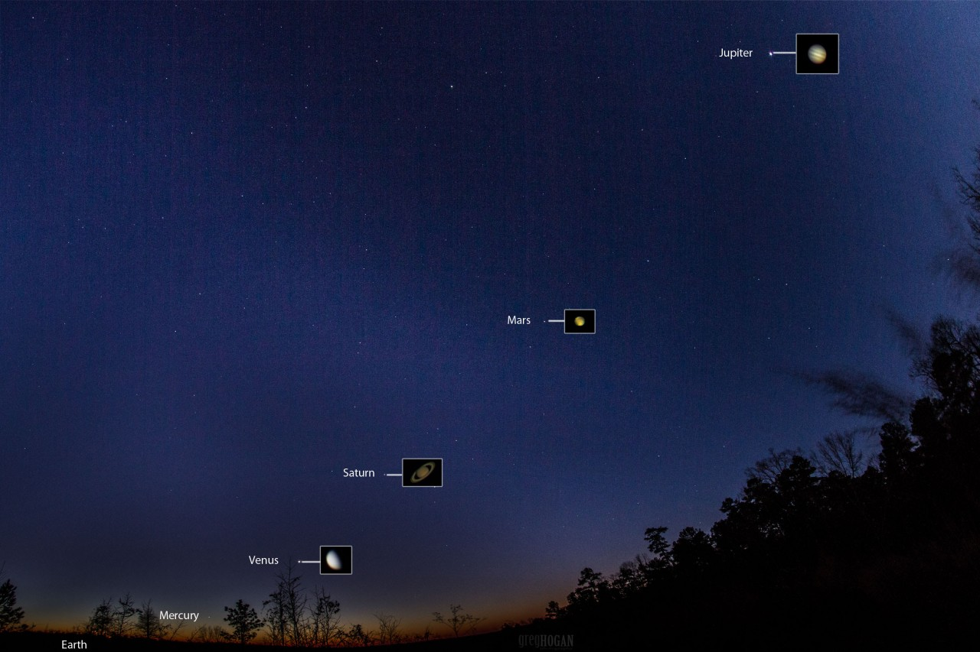
From planet movement to sky images
7
Notes:
mario:
Our project starts with understanding the movements of planets around the Sun. But, to observe these movements from Earth, we need to transform these movements into something we can see in our sky.
First, we start with the solar-centric view, where the Sun is at the center, and the planets move around it.
Next, we switch to an Earth-centric view. Now, Earth is at the center, and we can observe how other celestial objects move relative to our planet.
Finally, we make one more transformation, considering an observer's specific point on Earth.
This allows us to see the sky as it would appear to that observer. Through this process, we can convert the movements of the solar system into specific paths of stars and planets across our sky."

Slide 8
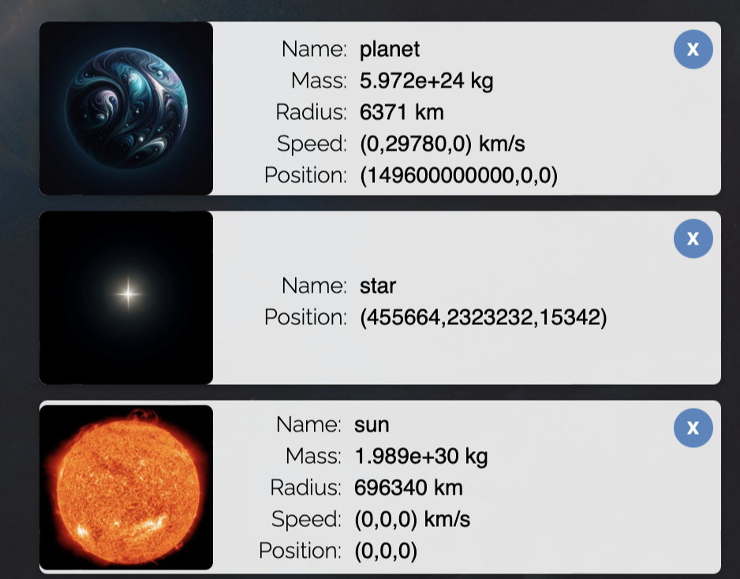
The Model: objects
Planets
Stars
Sun
8
Notes:
Mario:
The main objects that are included in the model are the sun the moon the earth and the stars for the sun we only initialize the mass and the radius and for the rest of the objects we initialize the mass the radius the starting position and the starting speed and of course over time the speed and the position of the objects change accordingly

Slide 9
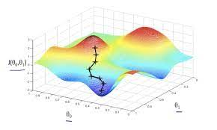
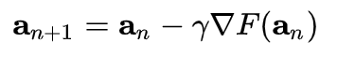
Parameters estimation
Searching the minimum of difference function: F=observed-predicted
Parameters optimization using Gradient descent method.
9
Notes:
In our project, we employ a parameter estimation approach to optimize our model's accuracy and reliability. We compare two sets of pictures: the observed pictures and the ones predicted by our model. Each set is a function of various parameters, such as object locations. Our objective is to find the parameter values that minimize the discrepancy between the observed and expected pictures.
To achieve this, we search for the minimum of each function by utilizing its derivative. This approach is commonly known as gradient descent. the gradient descent method is an iterative algorithm for optimization. The algorithm adjusts the parameters based on an objective function that quantifies the difference between the observed and expected pictures. Through successive iterations, the algorithm updates the parameter values in the direction of the steepest descent, gradually reducing the discrepancy.
The algorithm starts with an initial set of parameters and iteratively updates them based on the derivative of the function. At each iteration, the parameters are adjusted by taking steps proportional to the negative gradient of the function by following the negative gradient direction we get closer to the minimum of the function.
The iterative nature of gradient descent allows us to converge towards the optimal parameter values that result in a close alignment between the observed and expected pictures. By refining the parameters, we enhance the accuracy of our model in predicting celestial motions.

Slide 10
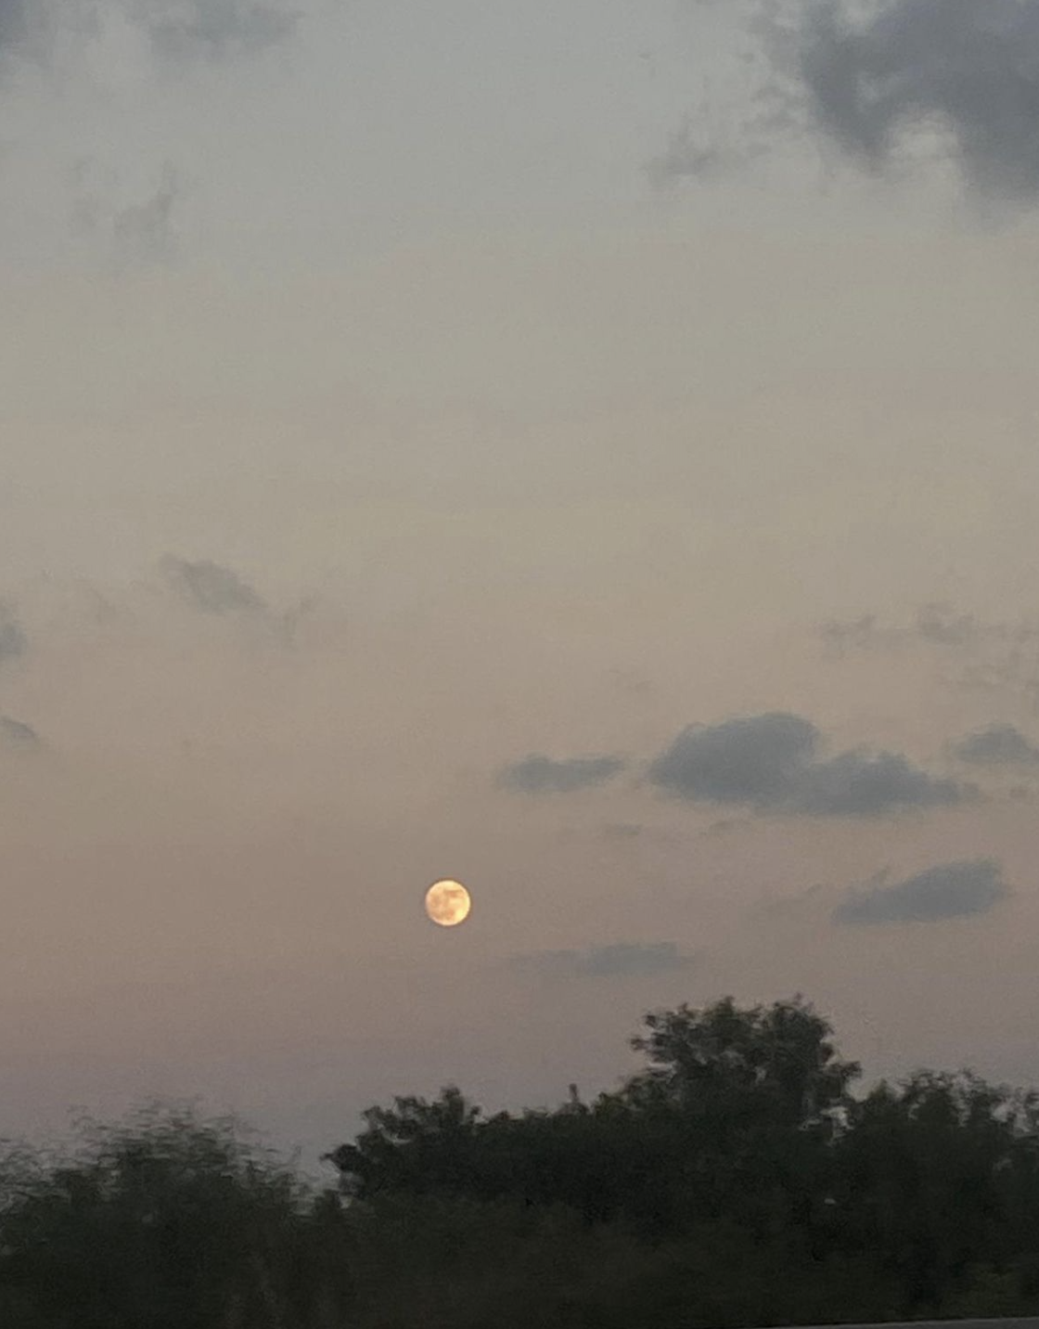
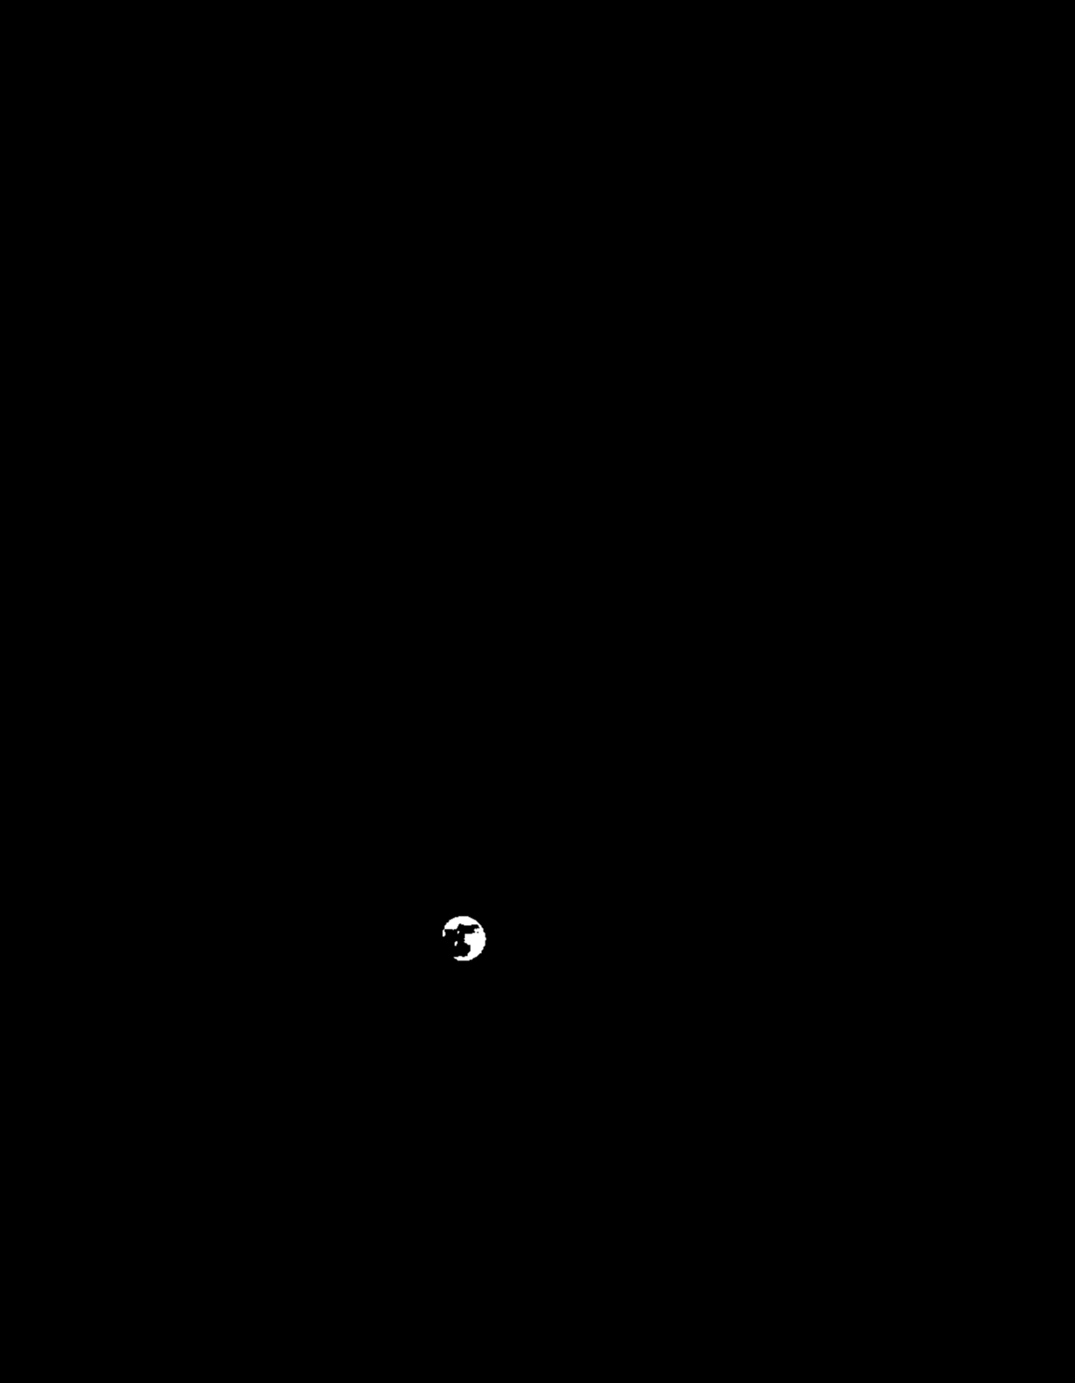
Image processing
Background Subtraction
Thresholding
Blob Detection
10
Notes:
Mario:
First we use background Subtraction to separate the background from the objects so we can identify them more effectively
Then we use thresholding to identify the specific object if its a really bright then it’s probably the sun moon or planets and if it’s not then its the stars
We also use Blob Detection to identify the object according to the size of it, if its big then its sun,moon and if its small then it’s a star

Slide 11
Pseudocode
FUNCTION estimate_parameters:
1. Analyze observed tracks
2. RETURN estimated parameter values
MAIN:
1. CALL build_model
2. CALL automatic_tracking on simulated model
3. CALL automatic_tracking on real sky images
4. CALL estimate_parameters on observed tracks
5. OUTPUT results
1. Initialize celestial object parameters
2. Load real observed sky images
FUNCTION build_model:
1. Implement celestial motion equations
2. Simulate sky view according to the model
3. RETURN simulated sky view
FUNCTION automatic_tracking:
1. Implement image processing techniques
2. Detect Objects
3. RETURN detected and tracked objects
11
Notes:
Train and apply machine learning models for object identification and tracking
FUNCTION build_model:
1. Implement celestial motion equations based on object parameters

Slide 12
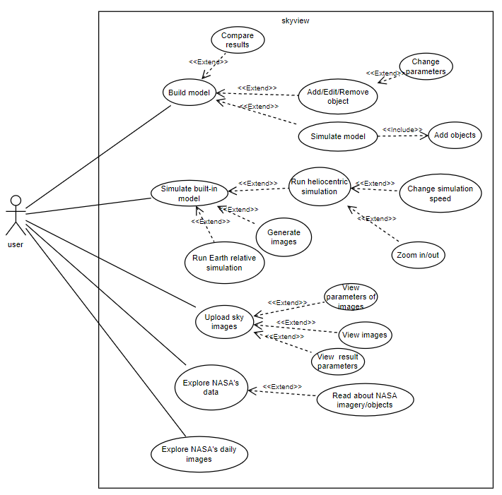
Use case
12

Slide 13
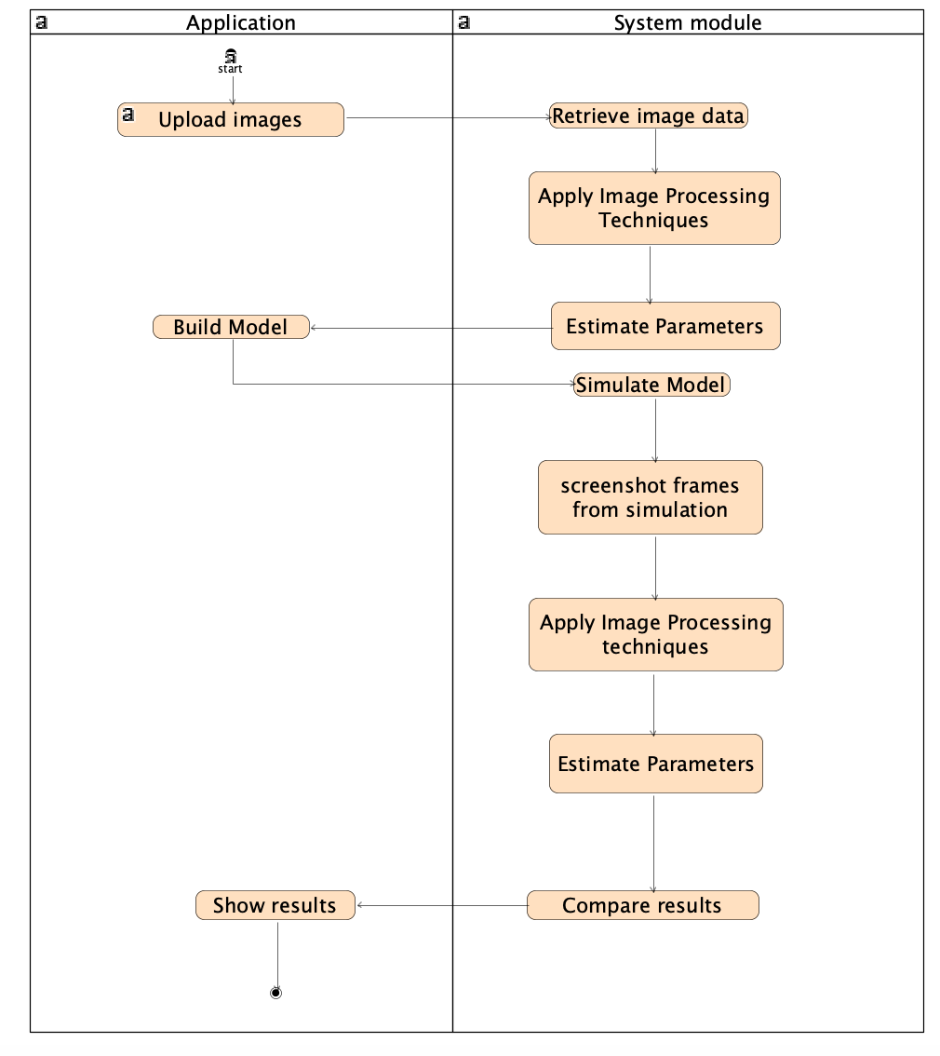
Activity diagram
13

Slide 14
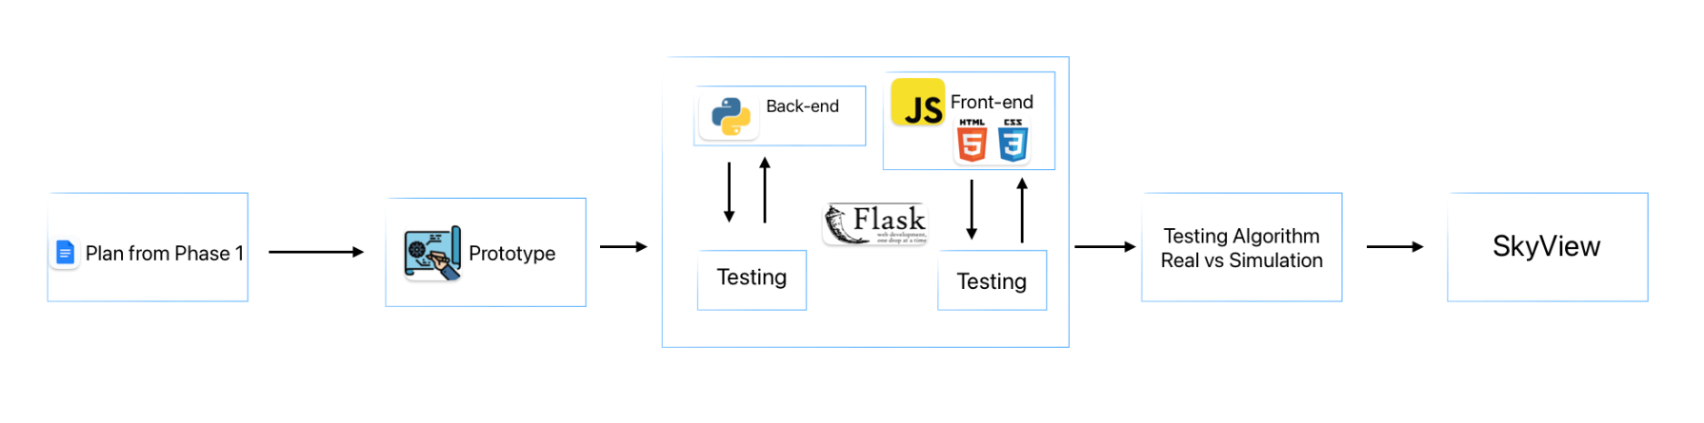
Development Workflow Overview
14

Slide 15
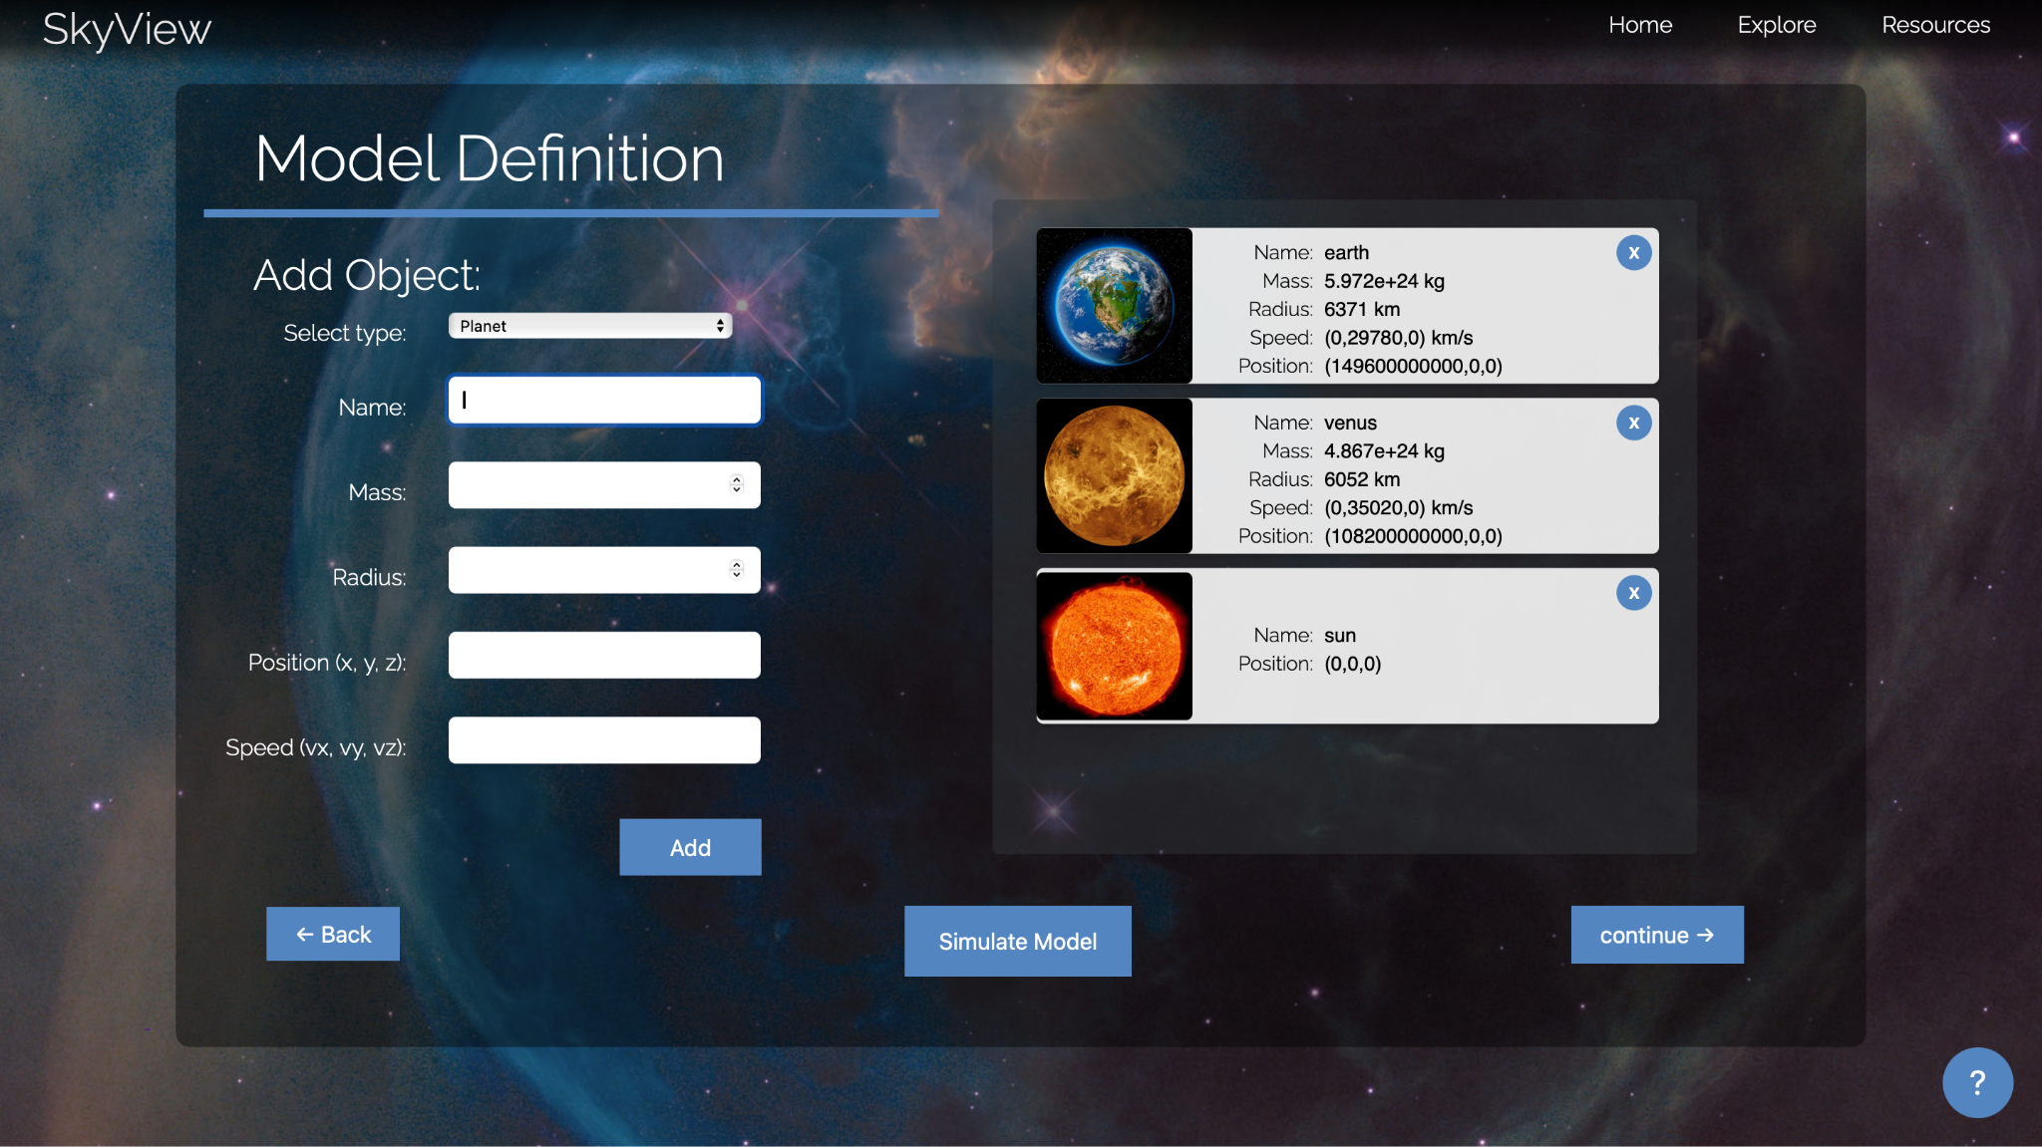
GUI
15

Slide 16
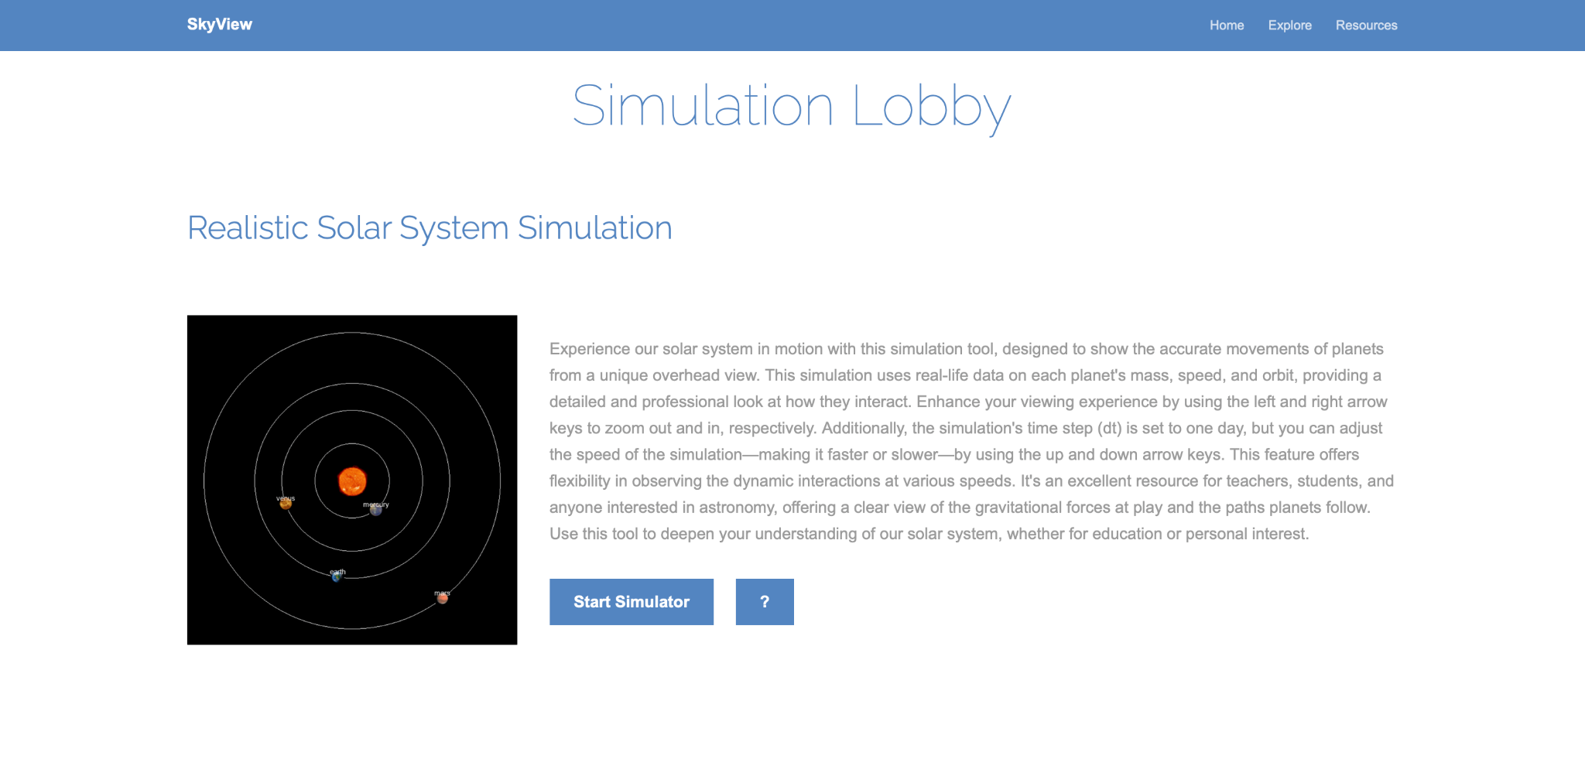
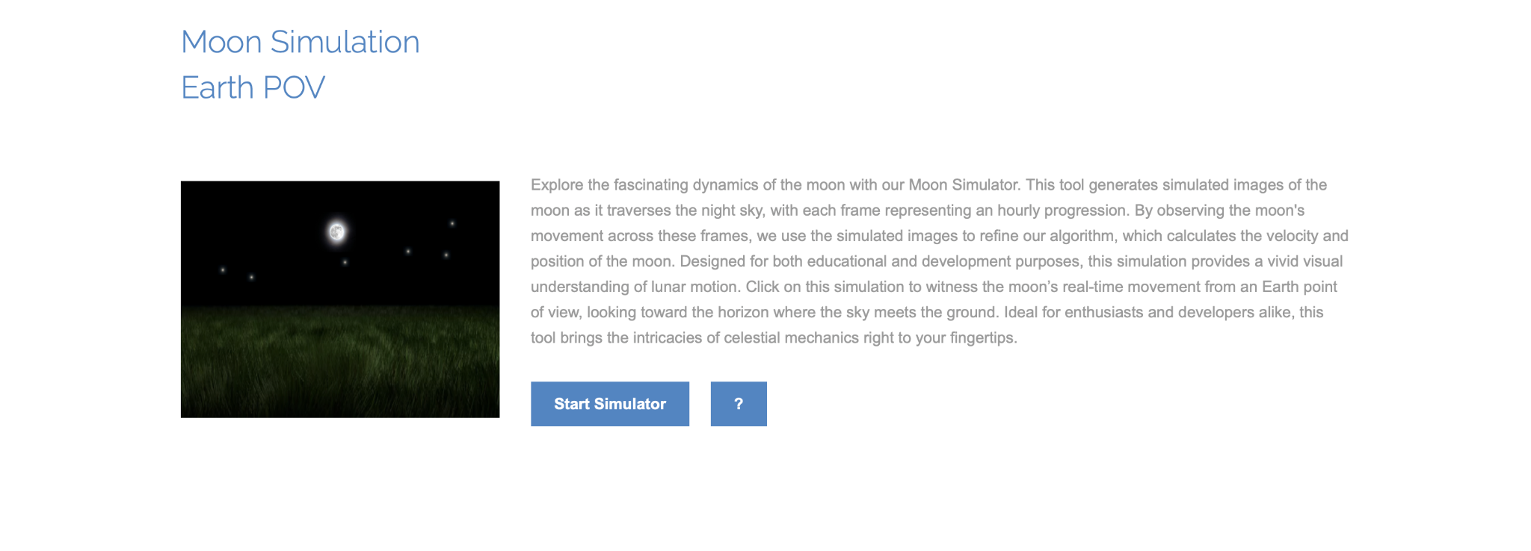
GUI
16

Slide 17
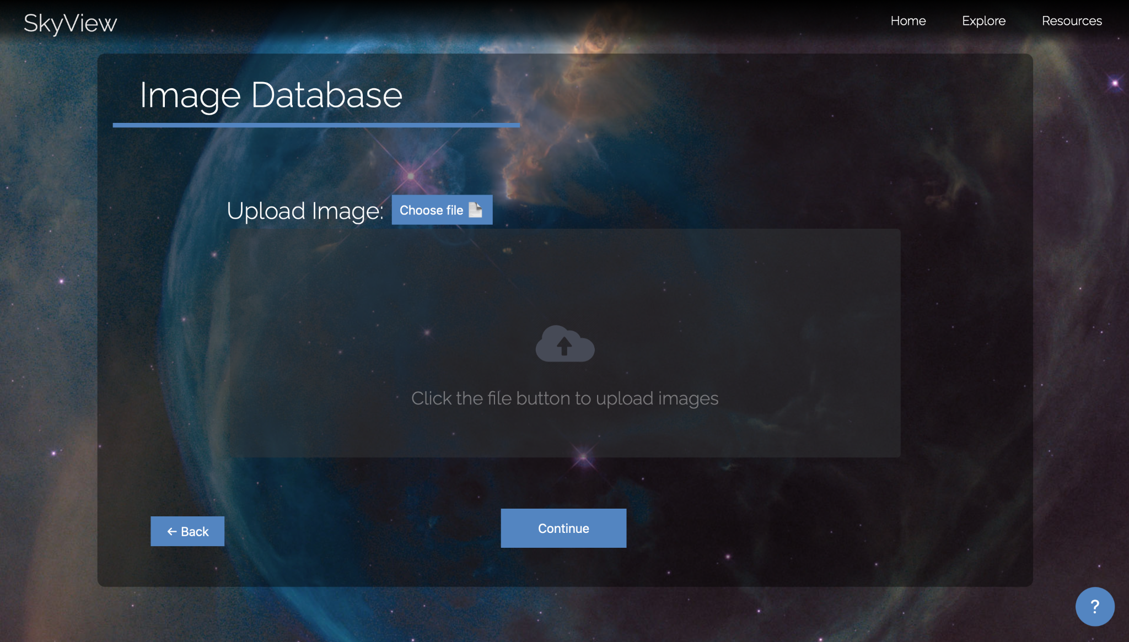
GUI
17

Slide 18
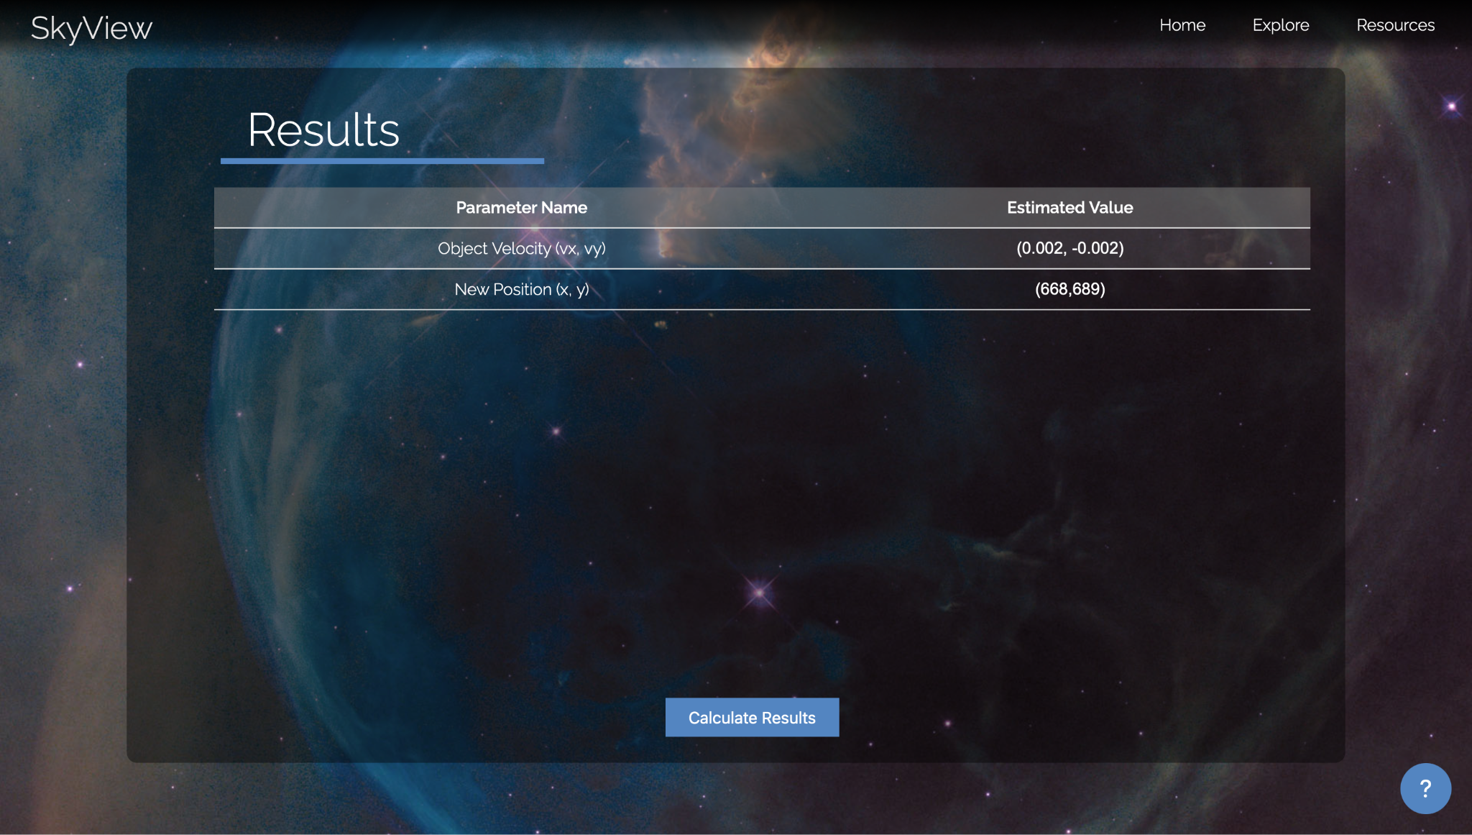
GUI
18

Slide 19
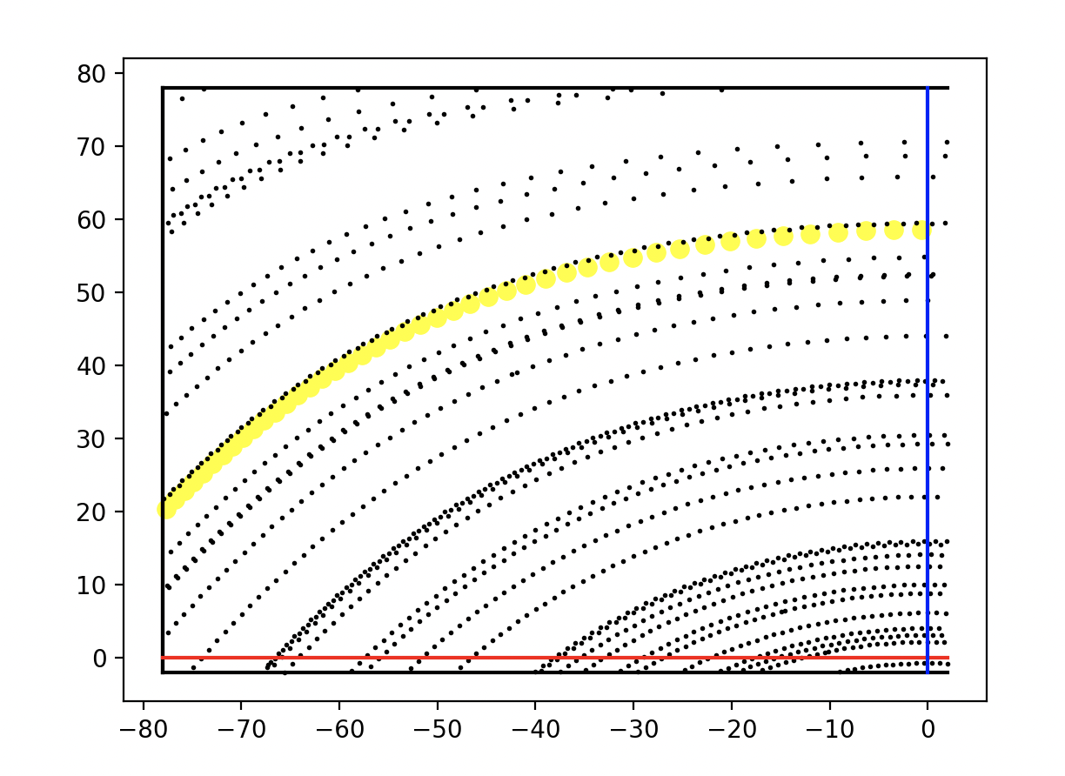
Results
Visualization of objects with given parameters.
Stars and sun movement visualization due to Earth’s rotation.
Moon movement and phases visualization.
20
Notes:
ibraheem

Slide 20
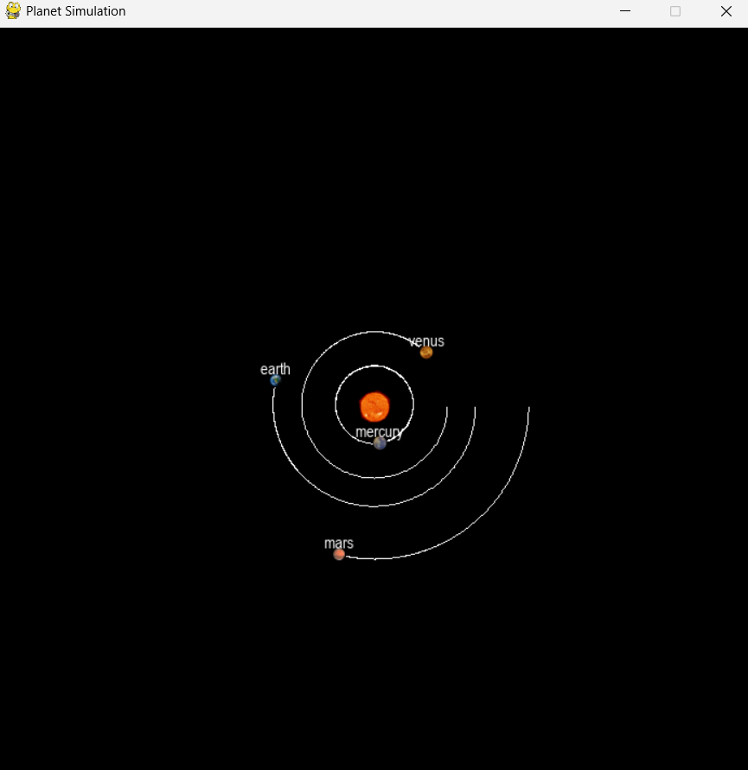
Results
2. Simulation of planets movement based on classic physics laws.
Updating position and velocity using newton’s model calculation.
Visualizing the planets movement around the sun.
21
Notes:
ibraheem

Slide 21
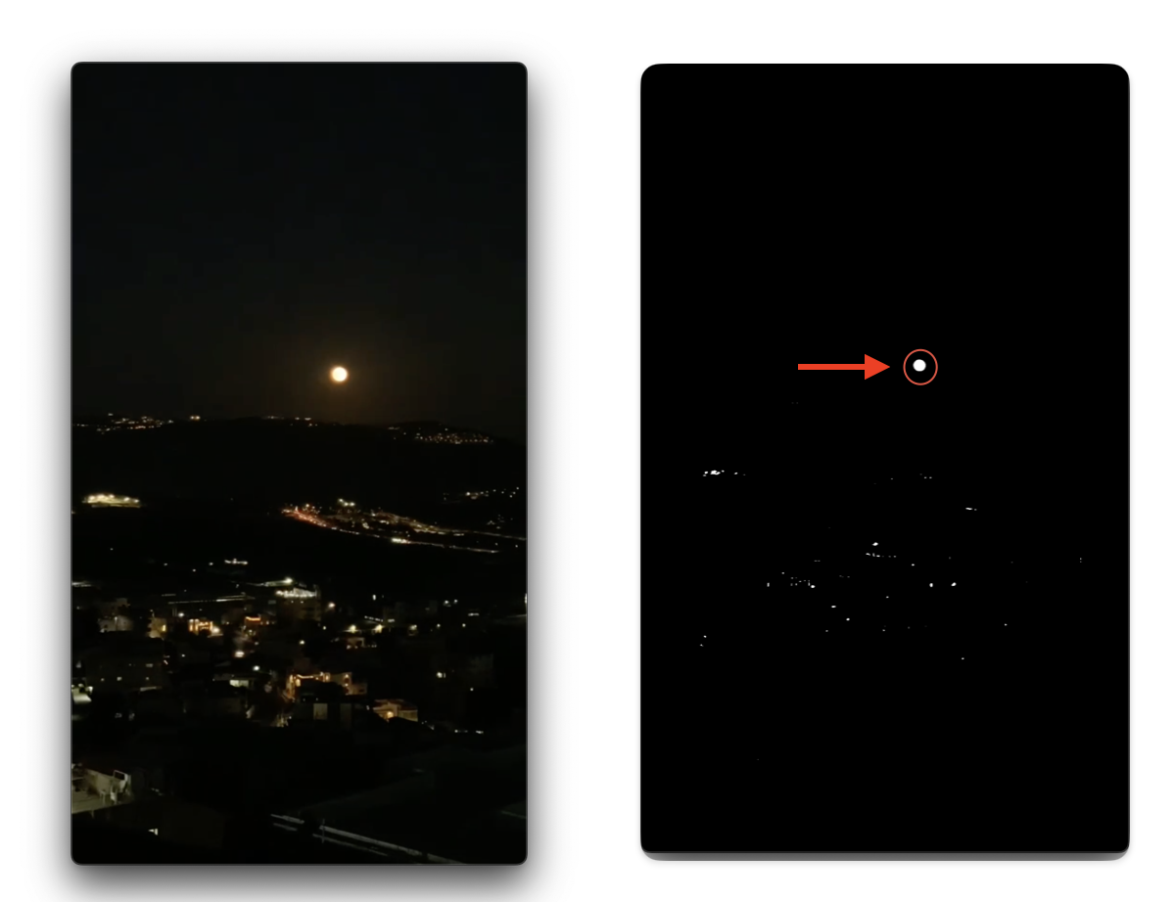
Results
3. Image processing
Detecting the Object.
22

Slide 22
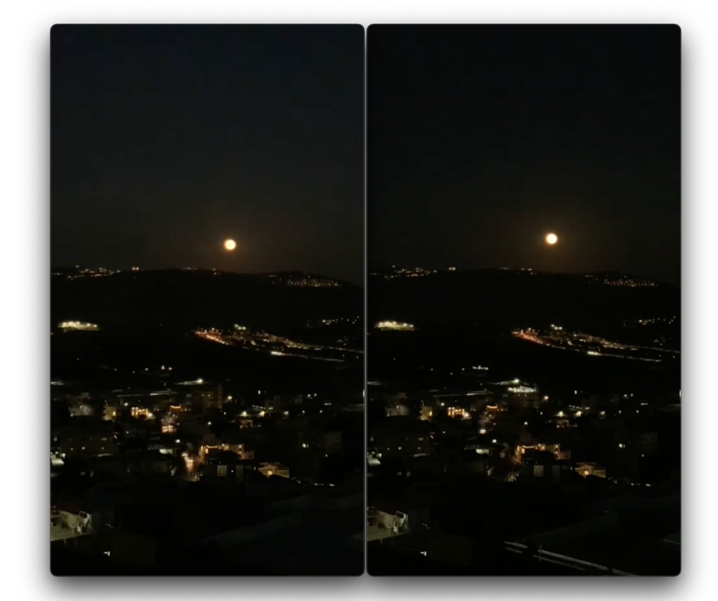
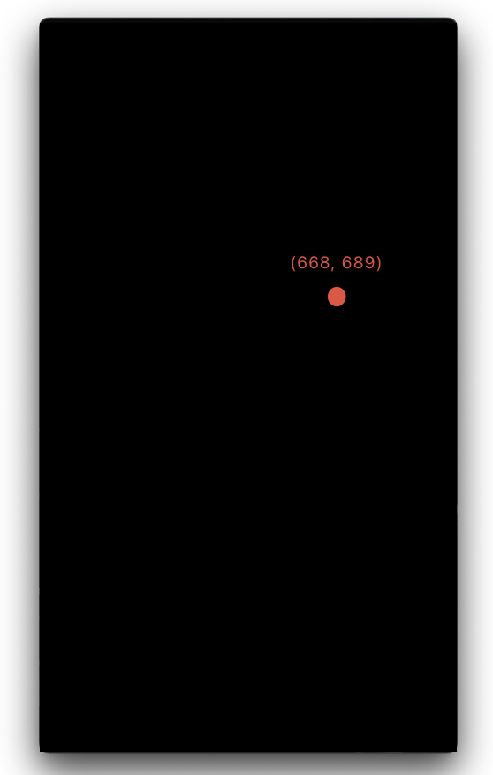
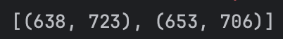
Calculating the position.
23

Slide 23
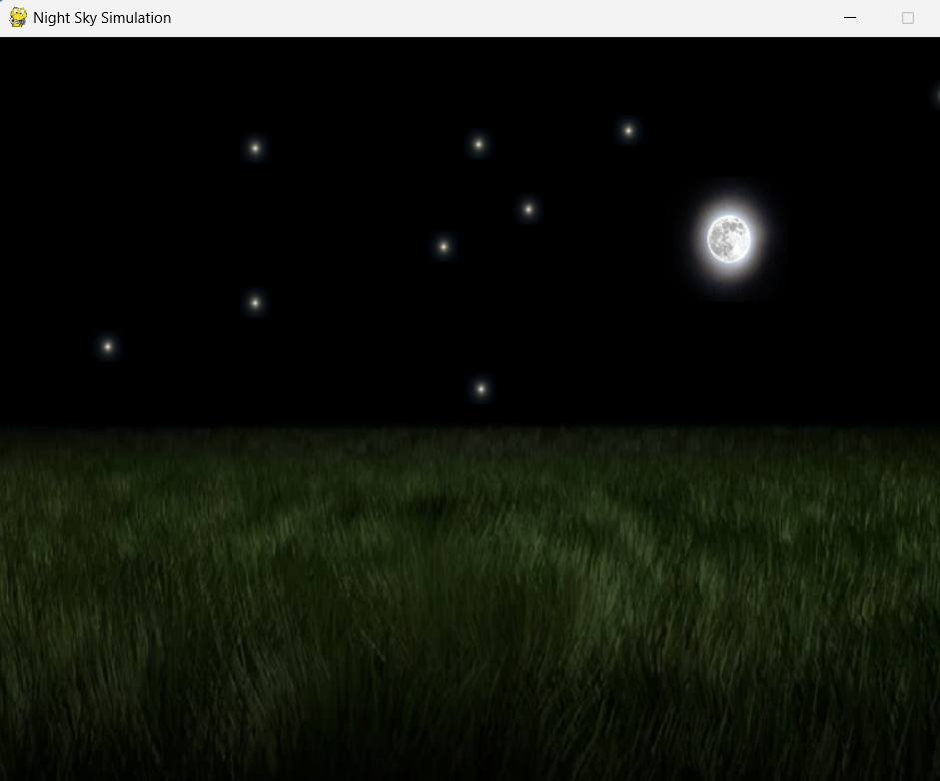
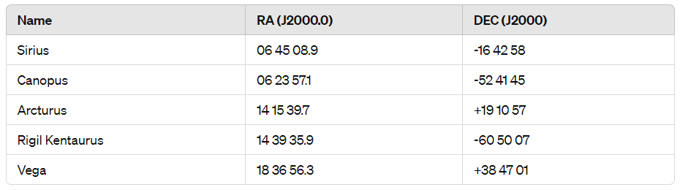
Results
4. Restoration of declination and right ascension, relatively to observer position based on position on the image,date and time,position of observer and camera’s direction.
24
Notes:
For each star and the Sun we show modelled position on the sky in consecuent time moments. For stars, esulted trajectories are circles with center in the Polar. Trajectory of the Sun is some different from the part of the circle.

Slide 24
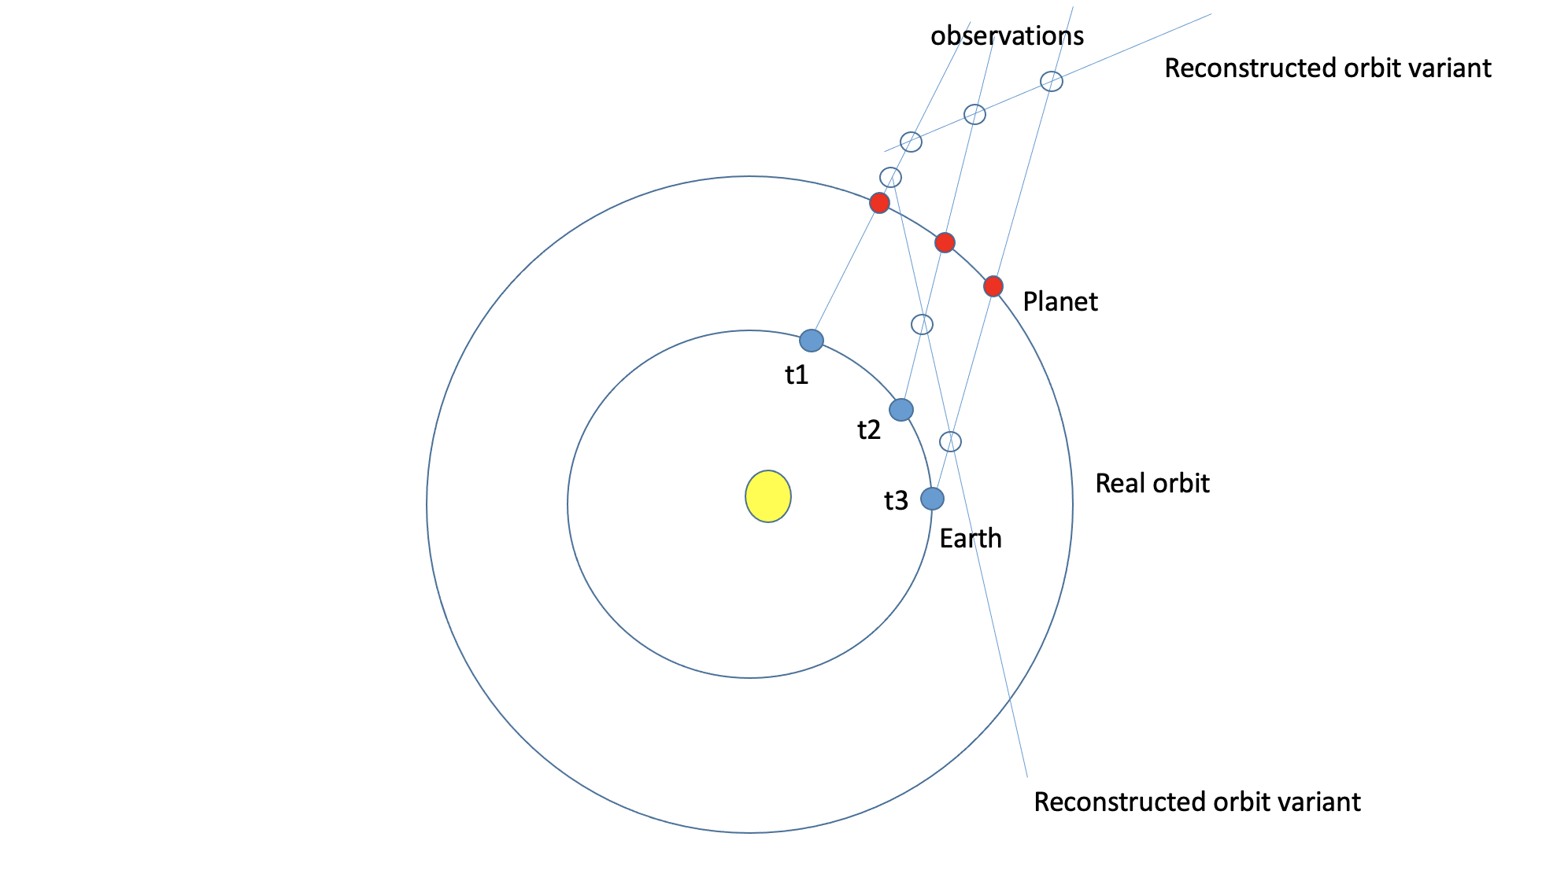
Prospects and open questions
We could restore object’s direction but could not restore object’s distance.
25

Slide 25
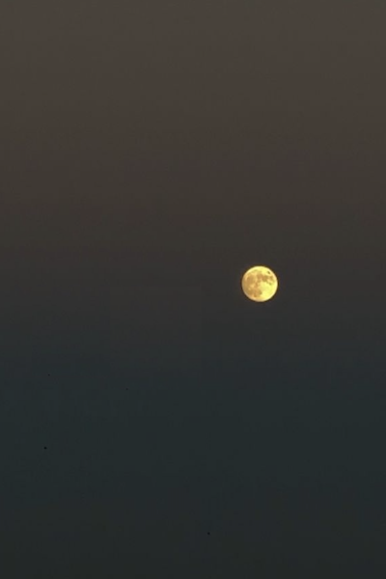
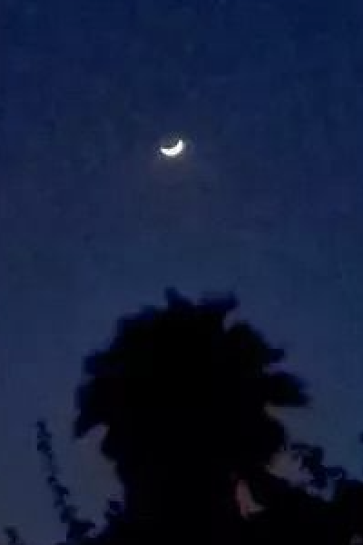
Prospects and open questions
2. Could not restore object’s parameters like mass, speed and position.
Due to the lack of parameters such as the distance.
May need to take into account the object’s size
26

Slide 26
Prospects and open questions
3. Effects on our model.
Accuracy of parameters restoration.
Predicting invisible objects.
27

Slide 27
video
https://drive.google.com/file/d/1N5Oj9jPxT1GQU7algxgst_FdYmqBJA9p/view?usp=sharing
28

Slide 28
Thank you
29

